Slide 1
Chapter # 07: The Arbitrage Pricing Theory
Chapter Outline:
Concept and understanding of Arbitrage Pricing Theory (APT) ;
Application & Benefit of APT
Assumptions of APT
Significance of APT
Comparison with CAPM and Arbitrage Pricing Theory
Single-Factor & APT Model
APT with an infinite number of securities;
APT with a finite number of securities;
Empirical tests of APT;

Slide 2
7.1 Concept and understanding of APT
Arbitrage pricing theory (APT) is a valuation model. Compared to CAPM, it uses fewer assumptions but is harder to use. The basis of arbitrage pricing theory is the idea that the price of a security is driven by a number of factors. These can be divided into two groups: macro factors and company specific factors. Stephen Ross developed the theory in 1976.

Slide 4
Contd.
The APT (Ross, 1976) holds that return of a stock depends on several economic and industry factors rather than assuming only the market factor like CAPM. In the APT, sensitivity to any of the macro economic factors are represented by their respective beta coefficient. The APT assumes that there exist a linear relationship between return of the risky assets and macro economic variables. Chen, Ross and Roll (1986) identified five factors model to analyze stock return.

Slide 5
Contd.
Ross stated the return on a stock must follow a very simple relationship that is described by the following formula:
Expected Return = rf + b1 x (factor 1) + b2 x (factor 2)... + bn x (factor n)

Slide 6
Where:
rf = the risk free interest rate, which is the interest rate the investor would expect to receive from a risk-free investment. Typically, U.S. Treasury Bills are used for U.S. dollar calculations, while German Government bills are used for the Euro
b = the sensitivity of the stock or security to each factor
factor = the risk premium associated with each entity

Slide 7
Contd.
APT, describes a mechanism used by investors to identify an asset, such as, a share of common stock, which is incorrectly priced. Investors can subsequently bring the price of the security back into alignment / configuration with its actual value.

Slide 8
This theory predicts a relationship between the returns of a portfolio and the returns of a single asset through a linear combination of many independent macro-economic variables.
APT uses the risky asset's expected return and the risk premium of a number of macro-economic factors.

Slide 9
7.2 Application & Benefit of APT
Arbitrageurs use the APT model for making profit by taking advantage of mispriced securities. A mispriced security will have a price that differs from the theoretical price predicted by the model. APT, describes a mechanism used by investors to identify an asset, such as, a share of common stock, which is incorrectly priced. Investors can subsequently bring the price of the security back into alignment / configuration with its actual value.
By going short an over priced security, while concurrently going long the portfolio, the APT calculations were based on, the arbitrageur is in a position to make a theoretically risk-free profit.

Slide 10
Contd
APT is based on the law of one price which sates that two otherwise identical assets cannot sell at different prices. APT assumes that assets return are linearly related to a set of indexes where each index represents a factor that influence s the return on an asset.

Slide 11
7.3 Essence / Spirit of the Arbitrage Pricing Theory
Given the impossibility of empirically verifying the CAPM, an alternative model of asset pricing called the Arbitrage Pricing Theory (APT) has been introduced by Ross , 1976.
A security’s expected return and risk are directly related to its sensitivities to changes in one or more factors (e.g., inflation, interest rates, productivity, etc.)

Slide 12
7.3 Assumptions of APT
Unlike CAPM, APT assumes ,
Investors have homogenous beliefs;
Investors are risk averse utility maximizes
Markets are perfect

Slide 13
7.4 Calculating Asset’s Return with APT
As per APT, formula for calculating asset’s expected rate of return is:
E(rj) = rf + bj1RP1 + bj2RP2 + bj3RP3 + bj4RP4 + ... + bjnRPn
where:
E(rj) = the asset's expected rate of return
rf = the risk-free rate
bj = the sensitivity of the asset's return to the particular factor
RP = the risk premium associated with the particular factor

Slide 14
The general idea behind APT is that two things can explain the expected return on a financial asset:
1) macroeconomic/security-specific influences and
2) the asset's sensitivity to those influences. This
relationship takes the form of the
linear regression formula above.
There are an infinite number of security-specific influences for any given security including inflation, production measures, investor confidence, exchange rates, market indices or changes in interest rates. It is up to the analyst to decide which influences are relevant to the asset being analyzed.

Slide 15
7.4 Significance of APT
The APT was a revolutionary model because it allows the user to adapt the model to the security being analyzed. With other pricing models, it helps the user decide whether a security is undervalued or overvalued and so he or she can profit from this information. APT is also very useful for building portfolios because it allows managers to test whether their portfolios are exposed to certain factors.

Slide 16
However, APT may be more customizable than CAPM, but it is also more difficult to apply because determining which factors influence a stock or portfolio takes a considerable amount of research.
It can be virtually impossible to detect every influential factor much less determine how sensitive the security is to a particular factor. But getting "close enough" is often good enough; in fact studies find that four or five factors will usually explain most of a security's return: surprises in inflation, GNP, investor confidence .

Slide 17
7.5 Difference between CAPM and Arbitrage Pricing Theory
The Arbitrage Pricing Theory and the Capital Asset Pricing Model (CAPM) are the two most influential theories on stock and asset pricing today.
The difference between CAPM and arbitrage pricing theory is that CAPM has a single non-company factor and a single beta, whereas arbitrage pricing theory separates out non-company factors into as many as proves necessary.

Slide 18
Arbitrage pricing theory does not rely on measuring the performance of the market. Instead, APT directly relates the price of the security to the fundamental factors driving it.
Each of these requires a separate beta. The beta of each factor is the sensitivity of the price of the security to that factor.

Slide 19
Contd.
Intuitively, the APT makes a lot of sense because it removes the CAPM restrictions, and basically states "The expected return on an asset is a function of many factors as well as the sensitivity of the stock to these factors." As these factors move, so does the expected return on the stock, and therefore its value to the investor.

Slide 20
Contd.
In the CAPM theory, the expected return on a stock can be described by the movement of that stock relative to the rest of the market. The CAPM is really just a simplified version of the APT, whereby the only factor considered is the risk of a particular stock relative to the rest of the market, as described by the stock's beta.

Slide 21
Contd.
However, from a practical standpoint, CAPM remains the dominant pricing model used today. When compared to the Arbitrage Pricing Theory, the Capital Asset Pricing Model is both elegant and relatively simple to calculate.

Slide 22
Arbitrage Argument in APT
1. Arbitrage argument in APT
  When arbitrage opportunities exist, each investor wants to take as large a position as possible.
  It will not take many investors to restore equilibrium.
  Implications derived from no-arbitrage argument is stronger, because they do not depend on a large, well-educated investors.

Slide 23
2. Arbitrage argument in APT
  When arbitrage opportunities exist, each investor wants to take as large a position as possible.
  It will not take many investors to restore equilibrium.
  Implications derived from no-arbitrage argument is stronger, because they do not depend on a large, well-educated investors.

Slide 24
contd.
The problem with this is that the theory in itself provides no indication of what these factors are, so they need to be empirically determined. Obvious factors include economic growth and interest rates. For companies in some sectors other factors are obviously relevant as well - such as consumer spending for retailers.
The potentially large number of factors means more betas to be calculated. There is also no guarantee that all the relevant factors have been identified. This added complexity is the reason arbitrage pricing theory is far less widely used than CAPM.

Slide 25
APT With an Unlimited Number of Securities
Given an infinite number of securities, if security returns are generated by a process equivalent to that of a linear single-factor or multi-factor model, it is impossible to construct two different portfolios, both having zero variance (i.e., zero betas and zero residual variance) with two different expected rates of return. In other words, pure riskless arbitrage opportunities are not available.

Slide 26
APT With Limited Number of Securities
Several papers have placed further restrictions on the model to ensure that the APT pricing equation holds strictly in a ﬁnite economy. Connor (1984) shows that if an economy is insurable, i.e., through exchange it is possible to form portfolios that are free of idiosyncratic risk, then the APT pricing equation will be exactly linear in both the ﬁnite and the inﬁnite economies.

Slide 27
Wei (1988) provides a synthesis of the CAPM and the APT in a competitive equilibrium framework. He shows that in a ﬁnite economy, a linear-beta pricing equation will price all securities correctly if the market portfolio is included as an additional factor.
To obtain an exact pricing equation in ﬁnite economies, no-arbitrage should be defined with respect to utility rather than the payoff. The precise deﬁnition of no- arbitrage in a ﬁnite economy is as follows: An economy does not permit arbitrage if a zero investment, zero factor risk portfolio does not change the expected utility of the investor.

Slide 28
Pure Riskless Arbitrage Opportunities
(An Example)
If two zero variance portfolios could be constructed with two different expected rates of return, we could sell short the one with the lower return, and invest the proceeds in the one with the higher return, and make a pure riskless profit with no capital commitment.

Slide 29
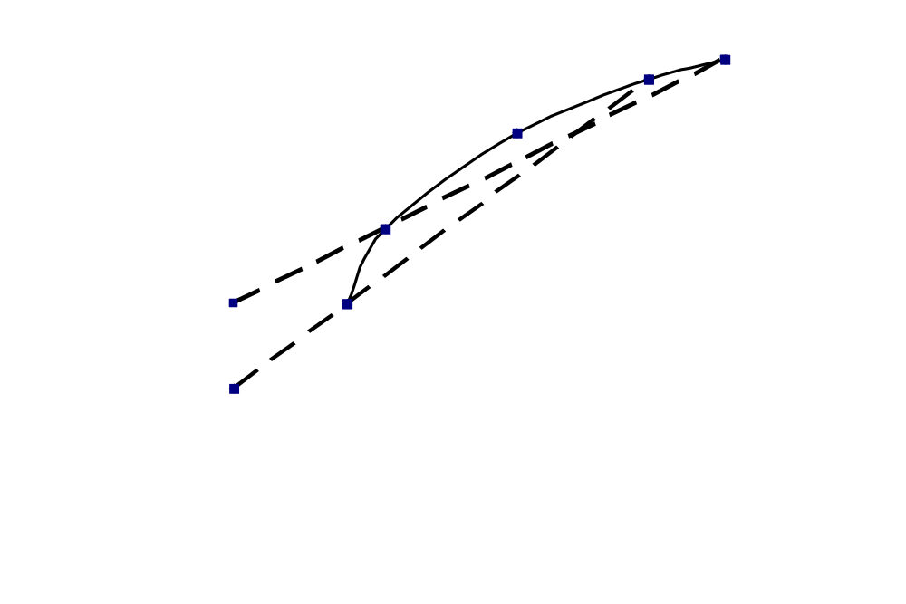
Pure Riskless Arbitrage Opportunities
(An Example) - Continued
Expected Return (%)
D
C
B
A
E(r_{Z})₁
E(r_{Z})₂
Factor Beta

Slide 30
“Approximately Linear” APT Equations
The APT equations are expressed as being “approximately linear.” That is, the absence of arbitrage opportunities does not ensure exact linear pricing. There may be a few securities with expected returns greater than, or less than, those specified by the APT equation. However, because their number is fewer than that required to drive residual variance of the portfolio to zero, we no longer have a riskless arbitrage opportunity, and no market pressure forcing their expected returns to conform to the APT equation.

Slide 31
Empirical Tests of the APT
Currently, there is no conclusive evidence either supporting or contradicting APT. Furthermore, the number of factors to be included in APT models has varied considerably among studies. In one example, a study reported that most of the covariances between securities could be explained on the basis of unanticipated changes in four factors:
  Difference between the yield on a long-term and a short-term treasury bond.
  Rate of inflation
  Difference between the yields on BB rated corporate bonds and treasury bonds.
  Growth rate in industrial production.

Slide 32
Is APT Testable?
Some question whether APT can ever be tested. The theory does not specify the “relevant” factor structure. If a study shows pricing to be consistent with some set of “N” factors, this does not prove that an “N” factor model would be relevant for other security samples as well. If returns are not explained by some “N” factor model, we cannot reject APT. Perhaps the choice of factors was wrong.

Slide 33
Using APT to Predict Return
Haugen presents a test of the predictive power of APT using the following factors:
  Monthly return to U.S. T-Bills
  Difference between the monthly returns on long-term and short-term U.S. Treasury bonds.
  Difference between the monthly returns on long-term U.S. Treasury bonds and low-grade corporate bonds with the same maturity.
  Monthly change in consumer price index.
  Monthly change in U.S. industrial production.
  Dividend to price ratio of the S&P 500.

Slide 34
Random Walk and Competing Theories
Generally, there are two competing approaches to predicting the movements of stocks: fundamental and technical analysis. In the sections below, we'll be taking a closer look at these competing theories, and how the random walk hypothesis aligns with each.

Slide 35
Fundamental Theorists
Fundamental analysts believe the price of a stock is a function of its intrinsic value, which depends heavily on the future earnings potential for a company. By carefully studying fundamental factors such as industry trends, economic news, and the company's earnings per share outlook, fundamental analyst can determine if the stock's price is above or below its intrinsic value.
Comparing a stock's price to its intrinsic value allows the fundamental analyst to predict the potential future direction of the stock's price.

Slide 36
Technical Theorists
Market analysts that practice technical techniques believe that historical movements of a stock's price can be used to predict future price direction. Using methods such as charting, the technical analyst will examine the sequence of upward and downward movements for a stock. These patterns of movements allow the technical theorist to chart what they believe will be future movements for the stocks they are examining.

Slide 37
Efficient Market Theorists
The next theory we're going to talk about is the efficient market hypothesis (EMH). Subscribers to this theory believe the price of a stock reflects all publically known information about a company. In fact, individuals subscribing to what is termed the "strong" EMH believe that stock prices also reflect what insiders know too.
Since public and private information concerning a company is instantly reflected in the market price of a stock, it's impossible for an investor to achieve "excess" returns. The principles of the random walk hypothesis are consistent with those of the efficient market hypothesis.

Slide 38
Random Walk Theory
Finally, the random walk hypothesis states that prices of stocks cannot be predicted. The stock market is "informationally efficient." The people buying and selling stocks consist of a large number of rational investors with access to this information. While long term prices will reflect performance of the company over time, short term movements in prices can best be described as a random walk.

Slide 39
Practical Implications RWH
The random walk hypothesis has some practical implications to investors. For example, since the short term movement of a stock is random, there is no sense in worrying about timing the market. A buy and hold strategy will be just as effective as any attempt to time the purchase and sale of securities.
When investors buy stocks, they usually do so because they believe the stock is worth more than they are paying. In the same way, investors sell stocks when they believe the stock is worth less than the selling price. If the efficient market theory and random walk hypothesis are true, then an investor's ability to outperform the stock market is more luck than analytical skill.

Slide 40
Arbitrage Pricing Theory
APT is introduced by Ross (1976).
Like the CAPM, APT predicts the relationship between the risk and equilibrium expected returns on risky assets.
However, the APT relies on no-arbitrage condition rather than the market portfolio.
To explain the APT, we begin with the concept of Arbitrage, which is the exploitation of relative mispricing among two or more securities to earn risk-free profits
A riskless arbitrage opportunity arises if an investor can construct a zero investment portfolio with a sure profit.

Slide 41
Arbitrage Pricing Theory
Since no investment is required, an investor can create large positions to secure large levels of profit.
  One has to be able to sell short at least one asset and use the proceeds to purchase one or more assets.
An obvious case of an arbitrage opportunity arises in the violation of the law of one price: When an asset is trading at different prices in two markets, sell short in the high priced market and buys it in the low priced market.
In efficient markets, profitable arbitrage opportunity will quickly disappear – Program trading and index arbitrage.

Slide 42
Arbitrage Example from Text
Current Expected Standard
Stock Price$ Return% Dev. %
A 10 25.0 29.58
B 10 20.0 33.91
C 10 32.5 48.15
D 10 22.5 8.58
Mean Stan.Dev. Correlation
Portfolio P(A,B,C) 25.83 6.40 0.94
D 22.25 8.58

Slide 43
Arbitrage Action and Returns
Expected Return
* P
* D
Standard Deviation
Short 3 shares of D and Buy 1 of A, B & C to form P (Arbitrage Portfolio: Zero-investment Portfolio).
You earn a higher rate on the investment than you pay on the short sale.

Slide 44
Arbitrage Pricing Theory
The critical property of an arbitrage portfolio is than any investor, regardless of risk aversion or wealth, will want to take an infinite position in it so that profits will be driven to an infinite level.
Because those large positions will force some prices up and/or some down until the opportunity is vanished, we can derive restrictions on security prices that satisfy that no arbitrage opportunities are left in the market place.
There is an important distinction between arbitrage and CAPM risk-versus-return dominance arguments in support of equilibrium price relationships.

Slide 45
Arbitrage Pricing Theory
Risk-vs-Return Dominance argument in CAPM
  It holds that when an equilibrium relationship is violated, many investors will make limited portfolio changes, depending on wealth and risk-aversion.
  Aggregation of limited portfolio changes over many investors will restore the equilibrium price.
Arbitrage argument in APT
  When arbitrage opportunities exist, each investor wants to take as large a position as possible.
  It will not take many investors to restore equilibrium.
  Implications derived from no-arbitrage argument is stronger, because they do not depend on a large, well-educated investors.

Slide 46
Well-diversified Portfolio and APT
APT: A theory of risk-return relationship derived from no arbitrage conditions in large capital market.
APT posits a single-factor security market.
R_{i} = α_{i} + β_{i}R_{M} + e, where R_{i} = (r_{i} – r_{f})
Suppose we construct a well-diversified portfolio with a given beta – No firm-specific risk.
R_{p} = α_{p} + β_{p}R_{M}
  If the portfolio beta is zero, R_{p} = α_{p}, implying a riskless excess return over risk-free rate.
  This implies that α_{p} should be zero, or else an immediate arbitrage opportunity opens up (borrow at risk free rate and buy zero-beta portfolio).

Slide 47
Well-diversified Portfolio and APT
Portfolio V (β_{v} and α_{v}) and Portfolio U (β_{u} and α_{u}).
  To form zero-beta portfolio (V+U); buy Portfolio V and sell Portfolio U with proportions of w_{v} = [-β_{u}/(β_{v}-β_{u})], and w_{u} = [β_{v}/(β_{v}-β_{u})]
  Riskless portfolio, but non-zero excess return unless α_{v} and α_{u} equal zero.
  Beta(V+U) = β_{v}[-β_{u}/(β_{v}-β_{u})] + β_{u}[β_{v}/(β_{v}-β_{u})] = 0
  R(V+U) = α_{v}[-β_{u}/(β_{v}-β_{u})] + α_{u}[β_{v}/(β_{v}-β_{u})] ≠ 0
The alpha of any well-diversified portfolio must be zero, even if the beta is not zero.
(r_{p} – r_{f}) = β_{p}(r_{M}– r_{f}); E(r_{p}) = r_{f} + β_{p}[E(r_{M}) – r_{f}]: Same as CAPM without any assumption about either investor preferences or access to market portfolio.

Slide 48
APT and CAPM Compared
APT applies only to well diversified portfolios and not necessarily to individual stocks in equilibrium.
However, APT relationship must almost surely hold true for individual securities.
  If APT relationship is violated by many individual assets, it would be virtually impossible for all well-diversified portfolios to satisfy the relationship.
APT serves many of same functions as the CAPM.
APT is more general in that it gets to an expected return and beta relationship without the assumption of the market portfolio.
APT can be extended to multifactor models.

Slide 49
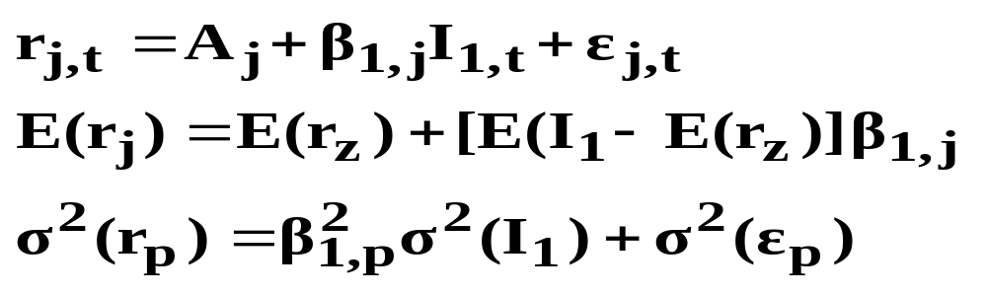
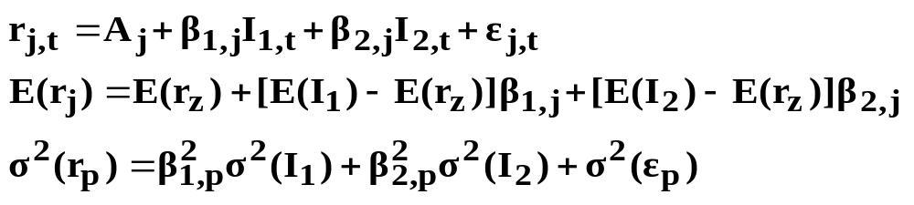
Multi-Factor APT Models
One Factor
Two Factors

Slide 50
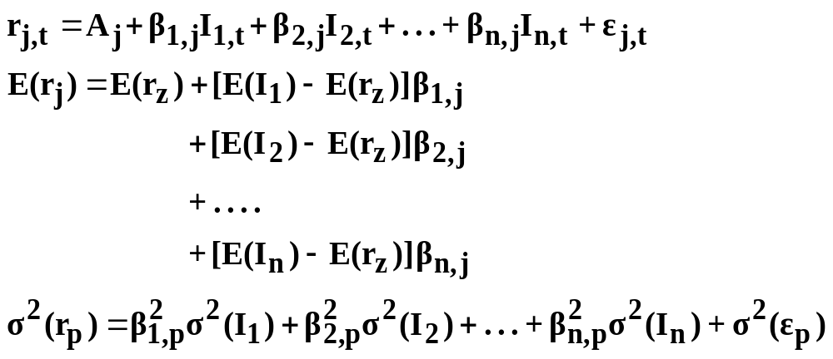
Multi-Factor APT Models
(Continued)
N Factors

Slide 51
Multifactor Generalization of APT
Use a multifactor version of APT to accommodate multiple sources of risk.
Generalize the single-factor model to a two-factor model: R_{i} = α_{i} + β_{i1}R_{M1} + β_{i2}R_{M2} + e.
Two-Factor APT
E(r_{p}) =
r_{f} + β_{p1} [E(r_{M1}) – r_{f}] + β_{p2} [E(r_{M2}) – r_{f}]

Slide 52
Summary
The general idea behind APT is that two things can explain the expected return on a financial asset: 1) macroeconomic/security-specific influences and 2) the asset's sensitivity to those influences. This relationship takes the form of the linear regression formula stated above.

